Slide 1

A deep dive into
Narcissistic Personality Disorder
By Kate Armstrong

Slide 2

It’s an illness, not a lifestyle.
May be genetic and/or environmental
Characterized by apathy and heightened sense of self-importance
*some may be aggressive while others appear highly sensitive
Examining this disorder will help us understand why/how it develops, how to work with these individuals, and how to help them.
Introduction
*Traits from Hooley et al, 2019
Notes:
Many people misunderstand narcissism to be a personality trait or choice that a cruel person will make. Fortunately for those suffering from this disorder, that’s not the case. Similar to depression or anxiety, narcissism is a disordered behavior that an individual experiences rather than actively decides to do. By examining this disorder closely, we can begin to understand the individual’s thoughts and hardships. This may allow us to offer better forms of help for these people and the loved ones their disorder may affect.

Slide 3
Part One:
Biopsychosocial Considerations

Slide 4
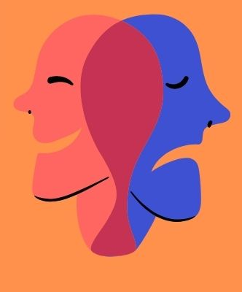
Biological
Traits or symptoms may be hereditary
Cardiovascular Disease
Gastrointestinal issues
*Hereditary info from Mayo Clinic, 2023
*Physiological conditions from Amen Clinics, 2023
Notes:
While narcissistic personality disorder is majorly linked to the individual’s environment, there may be biological causes as well. Genetics may play a role in developing NPD, mainly from similar traits inherited via a parent rather than the entire disorder. Additionally, NPD is linked to physiological issues, such as cardiovascular disease and gastrointestinal problems.

Slide 5
NPD may have other biological components- enter Oxidative Stress
“Oxidative stress is a molecular imbalance between antioxidants and free radicals, or reactive oxygen molecules in the body. The imbalance creates stress on the body because it must metabolize excessive oxidative chemicals that go to the brain and throughout the body.”
*From Uchicago Medicine, 2020
Notes:
A new study performed by University of Chicago Medicine is linking NPD to oxidative stress. According to the study, people with NPD and BPD have elevated concentrations of the molecule responsible for Oxidative Stress. The body experiences increased stress levels because it is constantly fighting to metabolize.

Slide 6
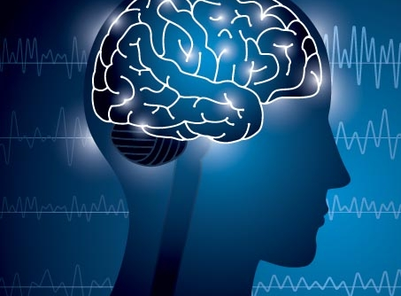
Psychological
Low self-esteem
Low emotional intelligence
Poor stress management or coping skills
Inability to empathize
Often a result of childhood trauma
  Being overwhelmingly criticized or praised
  Emotional or physical neglect
*Psychological traits from HealthDirect, 2021.
Notes:
No one chooses to have NPD. Most often, it occurs as a response to psychological stress experienced in childhood. It can stem from trauma, such as neglect or abuse, or being given overwhelming attention as a child. This attention, whether positive or negative, is what leads to the elevated sense of self-worth. These individuals generally have very low self-esteem, poor stress-coping skills, and are apathetic towards others’ feelings.

Slide 7
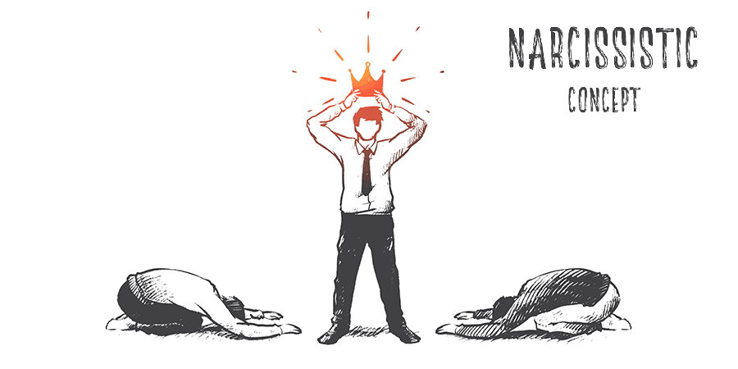
Social
Romantic stress
Friendships
Work
  Authority and team-work
Family
  Parent-child problems
  Sometimes labelled “Karen” in public/consumer relations
Notes:
The social components of Narcissistic Personality Disorder are vast. Unfortunately, individuals affected by NPD struggle with romantic relationships, families, work dynamics, and friendships. People who interact with NPD often feel inferior, insignificant, disrespected, or misunderstood by the individual because of their emphasized sense of self-importance. Families and romantic partners are generally most impacted by the person with NPD because they may care for them and feel as though they have to set their own boundaries or feelings aside in order to maintain the relationship. Coworkers, friends, and acquaintances are usually put in awkward power dynamics in which they don’t know how to respond to the individual.

Slide 8

Cultural Variation
NPD is a disorder of independence and self-sufficiency.
- Western and European societies value these traits
- Asian and Hispanic cultures highly value family, team-work, and codependency
Notes:
There is a cultural aspect to NPD, too. Not every individual with it will experience it the same, especially when comparing those with different values. Cultures that highly value individualism and self-dependence are more likely to breed narcissists. The United States, for example, has a high population of people with NPD. This is likely due to the culture’s emphasis on self-sufficiency. Areas that focus more on family values, such as many Asian and Hispanic cultures, are less likely to see narcissistic personalities.

Slide 9
Treatment
Different cultures will use different treatment methods.
Prescription medication/consultation with a psychiatrist
Psychotherapy
Cognitive and/or Behavioral Therapy
Support
NPD often goes mistreated because it affects the individual’s loved ones and environment rather than themself.
Notes:
The previously mentioned cultural variations can impact what treatment is effective for those with NPD. Mental health and personality disorders are viewed differently in different cultures. For example, some cultures are less accepting of therapy. Some view medication as limiting or masking one’s personality or abilities. In order to work with different beliefs and morals, there are different methods of treatment for NPD. Medication, different forms of therapy, self-help, and plenty of support from loved ones will help a narcissist cope with their disorder. The main issue is not necessarily obtaining treatment, though. In most cases, the person with NPD will not seek treatment because they are not negatively affected by their disorder. Rather, it impacts those around them.

Slide 10

Community
Spreading awareness
Breaking the stigma
Education of NPD and mental health care
Programs to connect those with NPD and other personality disorders
Notes:
There is a communal role in treating NPD. Similar to psychopathy or schizophrenia, NPD is heavily misunderstood. Many community spaces weaponize the disorder, viewing it as a personality trait rather than a medical condition. However, communities can help provide access to treatment for NPD. By spreading mental health awareness, providing education on Narcissistic Personality Disorder, and connecting those who have this disorder with each other.

Slide 11
Part Two:
Diagnostic/Evaluative Considerations

Slide 12
Assessment Tools
Narcissistic Personality Index (NPI)
DSM-5
Personality Diagnostic Questionnaire-4
Cloninger’s Temperament and Character Inventory (TCI)
*from Miller at al, 2008
Notes:
Narcissistic traits are assessed using the Narcissistic Personality Index, or NPI. The DSM measures criteria as well, such as a grandiose sense of self-importance or hypersensitivity. PDQ-4 is a self-report measuring questionnaire made for personality disorders, which presents difficulties in clinical diagnoses. While the individual is likely to answer most honestly with self diagnoses, they are also likely to be inconsistencies and assumptions made about questions that cannot be clarified. TCI is also used to measure NPD.

Slide 13
Reliability and Validity
Grandiose versus Vulnerable
Grandiose narcissism has similar traits to ideal extraversion
Vulnerable narcissism appears as insecurities
  Depression and depersonalization
  Other psychological distress
NPI considered most reliable, despite being a self-report.
*From Miller at al, 2008 and Schmalbach et al, 2020.
Notes:
The first problem with these assessments is that they don’t account for the two distinct versions of NPD, specifically the DSM-IV. There is a grandiose or overt type in which the individual has a grand and even aggressive sense of self-esteem. These dominant, open personalities act similarly to extraverts, which adds to diagnosis difficulties. The second manifests in hypersensitivity, where the individual appears extremely vulnerable to criticism or any other negative feedback. Their self esteem is incredibly low, but the two correlate because both view themselves as highly important. Vulnerable narcissists initially may appear as simply insecure or responding to traumatic events or poor reassurance during childhood. Depression, depersonalization, and psychological distresses show similarities with NPD as well. Fortunately, however, NPI is considered highly and deemed reliable. The DSM-5, again, fails to recognize the two types of NPD, but is otherwise deemed reliable by psychiatrists.

Slide 14
Diagnosis by Exclusion
When other possible diagnoses are ruled out, the only one remaining is confirmed.
DOE is practiced most often with the following psychological illnesses:
Panic attack, anorexia tardive, Alzheimer's disease
Personality disorders have been previously diagnosed by exclusion, but there are few relevant, current cases of such with NPD.
*Listed illnesses from Fred, 2013.
Notes:
Diagnosis by exclusion is a problematic practice that is unfortunately used often in the medical field. Professionals resort to a final conclusion after all other possible disorders have been ruled out. In psychology, it is recorded to be used for panic attacks, a type of anorexia, and even Alzheimer’s. Fortunately, the psychology field of personality disorders have improved, but many professionals still negatively view PDs and thus provide poor treatment, including diagnoses. NPD is especially stigmatized. Still, there are very few relevant cases of DOE performed in cases of NPD, as the disorder is considered very specific and even dangerous. The following quote comes from an article discussing those with Personality Disorders and how they are viewed in the most professional settings, by real specialists.

Slide 15
“Those suffering from these conditions often describe themselves as ‘the patients psychiatrists dislike’. They are made to feel blamed for their condition, and are met with prejudice and an unhelpful approach from professional staff, who often wrongly equate personality disorder with violence towards others. Personality disorder has been described by sufferers as a ‘very sticky label’.”
From Snowden, 2003.

Slide 16

Assessments and DOE
Self-assessments are forms of Diagnosis by Exclusion
NPI
Temperament and Character Inventory
Assessments that are not inclusive are forms of DOE.
Notes:
Diagnosis by exclusion is not helped by self-reported assessments such as the NPI. The very nature of these types of self assessments, in fact, is a form of diagnosing by exclusion because they fail to consider any other disorder. The Temperament and Character Inventory, despite considered highly valid, may also be a form of DOE because it focuses only on Personality Disorders. In fact, any assessment that is not inclusive can be considered DOE.

Slide 17
DSM, Mental Health, & Clinical Practice
There is a complex relationship between the publication process of the DSM, the contribution of research in mental health, and the practice of clinicians.
If the DSM is inaccurate, then so are clinicians.
If clinicians are inaccurate, then so are diagnoses.
Psychology and psychiatry heavily rely on the DSM
Mental health research is constantly improving and changing…
Which means the DSM must change too!
Notes:
Relevant, current, and extensive research is crucial to advancing the DSM. The DSM strives to be accurate, and so all reliable and valid research is considered when publishing the DSM. Clinicians rely on the DSM for accuracy, as they use it to diagnose and even treat disorders such as NPD. This means that accurate mental health research must be accounted for in the frequently-changing DSM.

Slide 18
Part Three: Therapeutic Considerations

Slide 19
Therapeutic Approaches
*Psychoanalytic psychotherapy
“Talk” therapy
Group therapy
Family & couple’s therapy
Those with NPD may cause harm to personal relationships, especially with loved ones
Medication is also often prescribed to help treat disordered symptoms.
*From the NHS Foundation Trust
Notes:
The main therapy used to treat NPD is psychoanalytic psychotherapy. This “talk” therapy is meant to allow those with NPD to recognize their disordered thought patterns. A therapist will listen to the client talk about their thoughts and provide feedback on why those thoughts may occur and what they could mean or cause. Other considerations are group therapy, family, and couples’ therapy. These are often recommended because people with NPD often are unaware of harm they may be doing to their important personal relationships. This is due to the lack of empathy and lack of responsibility that NPD causes within the individual. By attending these therapies, those with NPD can repair those crucial relationships and help their loved ones find support as well.

Slide 20

Non-Pharmacological Approaches
Support care
Honesty from loved ones
Self-care
Goals
Masking
Regular sleeping and eating habits
Hygiene
Notes:
There are not many effective practices outside of therapy and medication other than general support care. Individuals with NPD should be honest with their loved ones and encourage their loved ones to be honest with them. They should also practice self care, such as keeping treatment goals and honoring their true emotions rather than constantly performing for others. Also, as narcissists have similar traits with depression, they should prioritize their self-care schedules, such as eating, sleeping, and hygiene.

Slide 21
Duty to Treat
NPD remains highly stigmatized, even by professionals.
All clinicians have a duty to treat whilst causing no harm.
Accurate diagnosing
Analyzing all resources
Making corrections & reevaluating where necessary
Notes:
Duty to treat and do no harm, or nonmaleficence, are parts of the medical oath that applies to psychologists and psychiatrists. When assessing and treating individuals with NPD, the first rule is always “do no harm”. Unfortunately, as previously mentioned, NPD is heavily stigmatized today, even by professionals. Still, all clinicians have a duty to treat and do no harm. This means diagnosing accurately, analyzing each available resource in order to provide the best treatment, and always reevaluating for error, even if the errors should not have occurred in the first place.

Slide 22

Conclusion
NPD is a mental disorder with harmful symptoms similar to depression
Grandiose and vulnerable narcissists: different levels of self-esteem, but the same levels of self-importance.
NPD is a highly complex disorder with a negative connotation. By sharing our knowledge and constantly expanding research on the condition, we can provide these individuals with safe, reliable treatment resources.
Notes:
NPD is a highly complex disorder with a negative connotation. Thus far, we know that it takes two forms characterized by an extreme sense of self-importance. Narcissists should be cared for as anyone suffering from a mental illness. Although they may be unaware of exactly what harm they could be doing, they still experience the drawbacks to their behaviors and deserve the same treatment as any other person suffering from a psychological illness. By sharing our knowledge and constantly expanding research on the condition, we can provide these individuals with safe, reliable treatment resources.

Slide 23
References
Amen Clinics Admins. (2023). Narcissistic Personality Disorder Treatment. Amen Clinics. https://www.amenclinics.com/conditions/narcissistic-personality-disorder/#:~:text=In%20terms%20of%20physical%20health,pain%20or%20suffering%20on%20others.
Bartosch, J. (2020, April 28). Study shows narcissistic personality disorder may have a biological component. UChicago Medicine. https://www.uchicagomedicine.org/forefront/research-and-discoveries-articles/study-shows-narcissistic-personality-disorder-may-have-a-biological-component
Emanuel Jauk, Dorothee Breyer, Philipp Kanske, Akio Wakabayashi. (2021). Narcissism in independent and interdependent cultures. Personality and Individual Differences (Volume 177, 2021, 110716, ISSN 0191-8869).
https://doi.org/10.1016/j.paid.2021.110716.
Fred H. L. (2013). The diagnosis of exclusion: an ongoing uncertainty. Texas Heart Institute journal, 40(4), 379–381.
HealthDirect Admins. (2021, December). Narcissistic personality disorder (NPD). healthdirect. https://www.healthdirect.gov.au/narcissistic-personality-disorder-npd#:~:text=It%20is%20probably%20a%20mixture,can%20also%20contribute%20to%20NPD.
Hooley, J. M., Nock, M. K., & Butcher, J. N. (2019). Abnormal Psychology (18th ed., pages 339-340). Pearson Education (US). https://mbsdirect.vitalsource.com/books/9780135191033

Slide 24
References Co.
Mayo Clinic Staff. (2023, April 6). Narcissistic personality disorder. Mayo Clinic. https://www.mayoclinic.org/diseases-conditions/narcissistic-personality-disorder/symptoms-causes/syc-20366662#:~:text=The%20cause%20is%20likely%20complex,such%20as%20certain%20personality%20traits.
Miller, J. D., Campbell, W. K., Pilkonis, P. A., & Morse, J. Q. (2008). Assessment procedures for narcissistic personality disorder: a comparison of the personality diagnostic questionnaire-4 and best-estimate clinical judgments. Assessment, 15(4), 483–492. https://doi.org/10.1177/1073191108319022
NHS Admins. (n.d.). Psychoanalytic Psychotherapy. NHS choices. https://tavistockandportman.nhs.uk/care-and-treatment/treatments/psychoanalytic-psychotherapy/#:~:text=Psychoanalytic%20psychotherapy%20is%20a%20talking,may%20contribute%20to%20your%20problems.
Schmalbach, B., Zenger, M., Nanette Tibubos, A., Borkenhagen, A., Strauss, B., & Brähler, E. (2020). The Narcissistic Personality Inventory 8: Validation of a Brief Measure of Narcissistic Personality. International journal of psychological research, 13(2), 68–77. https://doi.org/10.21500/20112084.4855
Sheenie Ambardar, M. (2021, July 19). Narcissistic personality disorder treatment & management. Approach Considerations, Psychotherapy, Pharmacologic Therapy. https://emedicine.medscape.com/article/1519417-treatment#:~:text=The%20mainstay%20of%20treatment%20is,%2Dterm%20objective%2Dfocused%20psychotherapy.
Snowden, P., & Kane, E. (2003). Personality disorder: No longer a diagnosis of exclusion. Psychiatric Bulletin, 27(11), 401-403. doi:10.1192/pb.27.11.401

Slide 25
Picture References
Chris Ryan. (2022). What is NPD? Getty Images. https://www.verywellmind.com/what-is-narcissistic-personality-disorder-2795446
Elnur. (2021). Woman with Mask During Psychologist Visit. Shutterstock. https://www.shutterstock.com/image-photo/woman-mask-during-psychologist-visit-1669293838
Hiro. (2020). Biological factors associated with changes in personality in maltreated adolescent girls. PsyPost. https://www.psypost.org/2020/01/biological-factors-associated-with-changes-in-personality-in-maltreated-adolescent-girls-55287
Larissa Biggers. (2022). 9 Signs of Narcissistic Personality Disorder. Duke Health. https://www.dukehealth.org/blog/9-signs-of-narcissistic-personality-disorder
LivLong Admins. (2022). What is a Narcissistic Personality Disorder? LivLong. https://livlong.com/blogs/health-and-wellness/what-is-a-narcissistic-personality-disorder
Marina. (2020). What Does it Mean to Have Narcissistic Personality Disorder? Domus Retreat. https://domusretreat.com/blog/narcissistic-personality-disorder/
Sane Australia. (2019). Narcissistic Personality Disorder. MyDr. https://mydr.com.au/mental-health/narcissistic-personality-disorder-npd/
Notes:
*all pictures were free-use images

