Slide 1
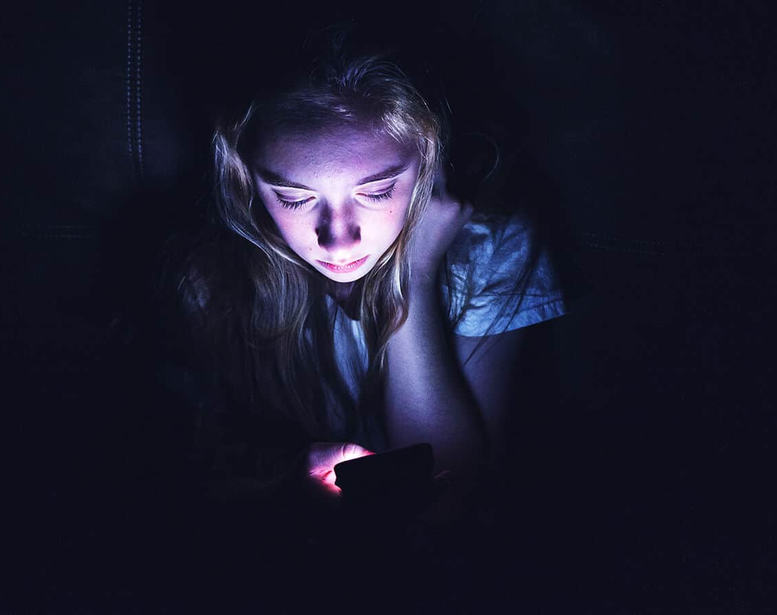
Share with a Friend
Social media is the newest- and easiest- addiction to sustain. Here’s how to stay connected AND comfortable online:
*Image from Power of Positivity, 2021
Notes:
Social Media is known for its ability to connect families, cultures, and complete strangers. Although it is a useful tool of the 21st century, it is also highly promotional of addictive behaviors and can become an addiction in itself.

Slide 2
Adolescents and Young Adults
Children, teenagers, and young adults are culturally captivated by social media.
Of adolescents ages 13-17:
62% Instagram
69% Snapchat
67% TikTok
95% YouTube
Of adults ages 18-24:
76% Instagram
75% Snapchat
55% TikTok
*Stats according to Pew Research Center, 2022.
Notes:
According to the Pew Research Center, most young adults and teenagers in the U.S. use social media. Statistics show that 76% of adults ages 18-24 use Instagram, 75% use Snapchat, and 55% use TikTok. Of teenagers ages 13-17, 62% use Instagram, 69% use Snapchat, 67% use TikTok, and 95% use YouTube.

Slide 3
Statistics
49% of Facebook users visit the site multiple times a day.
45% Snapchat
38% Instagram
29% of Tiktokers open the app daily. The average Tiktoker open the app eight times a day.
*Media stats according to Pew Research Center, 2022. TikTok stats from Wallaroo Media, 2023.
Notes:
An overwhelming number of big-platform users open these sites more than once a day. TikTok seemingly favors addictive behavior the most, with its users opening the app 8x and spending over 1.5 hours on it daily.

Slide 4
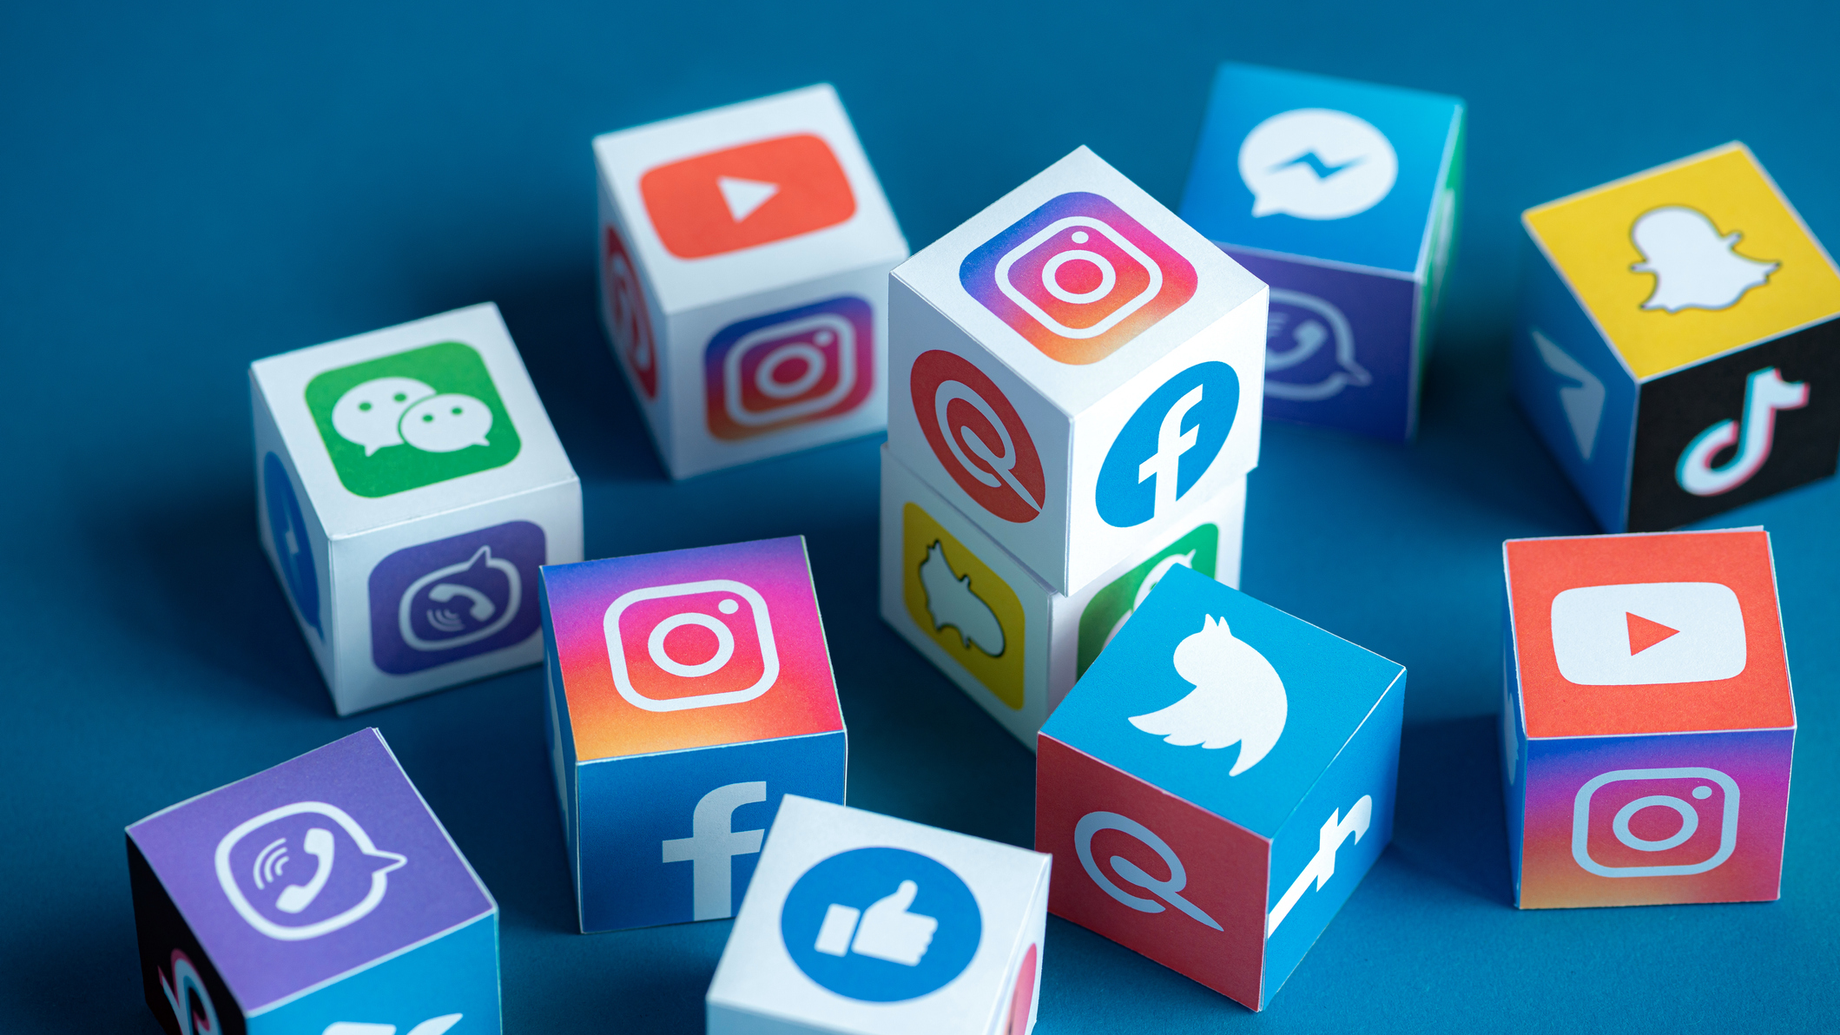
The Appeal & How Social Media Promotes Addictive Behavior
Everybody’s an influencer
“Going viral”
Short, high-quality videos
Multiple tabs/pages
Colorful, loud, distracting
Anti-climactic content with high suspense
“Necessary” notifications
  Direct messages, “your friend shared…”,
CTAs
  “Tag someone who does this”, “Share with a friend”, “Follow for more…”
“Wait for it…”, “You won’t believe what happens at the end!”
*Image by Ukraine, 2019.
Notes:
Social media is a unique, captivating form of entertainment. It’s not only entertaining, though, as a large number of users choose social media because they want their chance to go viral. Appealing visuals and frequent notifications keep users coming back and staying online for hours at a time. META’s platforms such as Instagram, WhatsApp, Messenger, and, of course, Facebook are designed to hold the user captive. TikTok’s format especially relies on short attention spans as the videos are short and often fast-paced. Facebook’s “watch” page does the opposite of this, often promoting incredibly low-quality videos stretched over several minutes and intended to keep the user waiting for a dramatic climax. It usually never comes, but the design keeps the user repeating this behavior over and over again despite obvious distress. What’s worse, these apps frame notifications as a necessity. The user must stay connected at all times in order to not miss out on events, their loved ones’ lives, news, and entertainment that they “can’t miss”. CTAs or Call-To-Actions are usually placed strategically in a caption and/or following a post. They’re used primarily by brands, but the rise of social media accessibility has led influencers and smaller platforms to use them as well. They tell the user to do something to further promote the brand, product, or post.

Slide 5
Doom-Scrolling
“A vicious cycle in which users find themselves get stuck in a pattern of seeking negative information no matter how bad the news is.”
Definition from Seydi et al, 2022
Notes:
Both a cause and effect of social media is Doom-Scrolling, and it sounds as scary as it is.

Slide 6
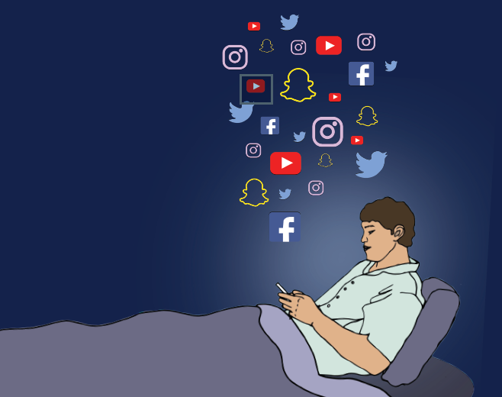
Consequences
Mental health:
Short, dramatic entertainment and distracting formatting shortens attention spans.
Constant awareness to news and the lives of loved ones increases stress and anxiety.
Other mental health damages such as loneliness, depression, suicidal thoughts.
Social:
Distracts from work
Disrupts relationships with loved ones (IRL!)
*Mental health stats from HelpGuide, 2023.
*Image by Salsbury, 2021.
Notes:
Chronic social media usage is damaging to mental health. The over-user may experience feelings of isolation, anxiety, depression, and difficulty concentrating.

Slide 7

From SixDegrees to Facebook: How Did We Get Here?
Social media has only been around as long as the internet.
MySpace launched in 2003, and Facebook famously followed the year after. Reports of addiction begun almost instantly.
Addiction stems from a form of pleasure or entertainment. Social media usage releases dopamine, the chemical responsible for reward and pleasure.
Chronic social media usage is a substance-use disorder.
*Dopamine definition from healthdirect, 2021.
Image by ZyMos, 2010.
Notes:
Contrary to popular belief, Social Media Addiction isn’t a Gen-Z problem nor their fault. MySpace was the first note-worthy social media site, launching in 2003, and the response was remarkable.

Slide 8
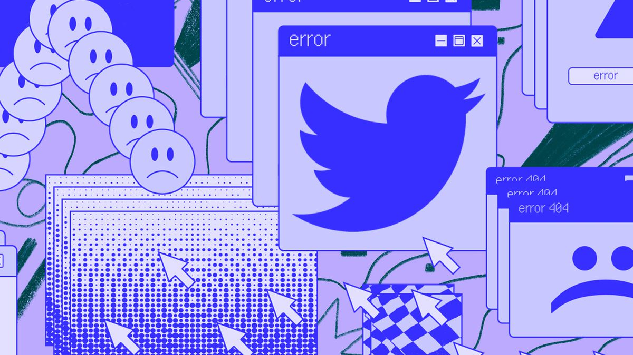
The idea that social media can be addictive is relatively new. However, the amount of people now reporting addiction is overwhelming.
40% of users ages 18-22 in 2019 reported feeling addicted to social media.
Age stats from Statista, 2022. Photo by Jennings, 2022.

Slide 9
Therapeutic Approaches to Social Media
Creating realistic screen-time goals
Set intentions on what you wish to consume
Know when you do and don’t “need” to be online
Target Triggers
Social Interventions
Cognitive Interventions
How to enjoy social media without damaging your mental & psychological health
Points 3-5 from Capuzzi & Stauffer, pages 163-164.
Notes:
Truthfully, there’s no ”cold-turkey” approach to social media. We live in a world where it is necessary to connect online be it for work, long-distance loved ones, or other personal endeavors. Social Media can be beneficial when enjoyed in moderation. Users should practice a mindful approach to their consumption, such as setting goals to keep screen-time down. They should also be aware of what information they may be unintentionally consuming- an example may be opening TikTok for entertainment yet ending up donating to a cause, or vice versa. Not all scenarios end badly, but setting intentions could help curve unwanted doom-scrolling. Users should also recognize when and what may trigger their social media usage, which is often simply a lack of stimulation. Simulating a social intervention is also helpful in reinforcing communication and social skills that social media consumption may damage. It also gives back some energy as media can be draining. Cognitive Interventions are incredibly effective as you train your brain to recognize which thoughts and behaviors are problematic. Instead of instantly opening Instagram while waiting in the elevator, the user would pause and consider why that was their instinct and what they could do instead.

Slide 10
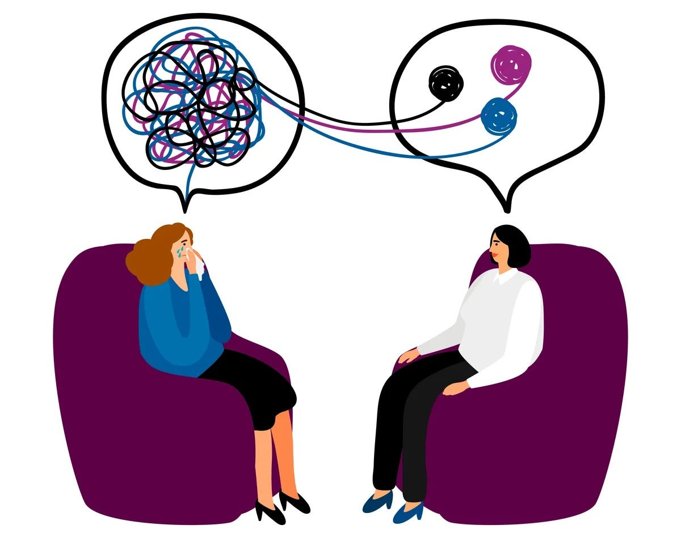
More Cognitive-Behavioral Therapy Help
Unplug for a few days; “Go Touch Grass!”
Community Reinforcement
Capuzzi & Stauffer, page 166. Image by Rathor, 2020.
Notes:
The popular comical phrase “go touch grass” recommends a real physical intervention for those who are “chronically online”. Users should take a pause to do something hygienic and/or productive; the idea is that another activity will temporarily- and sometimes for several hours or days- distract from the desire to scroll. Next is community reinforcement, which means seeking support within the user’s environment. Certain jobs may have a lot of free time that lead a user to scroll social media frequently during work. Roommates or relatives may disconnect from the user, leaving them to their phone. Although the user cannot necessarily control what happens around them, they can control what and who they surround themself with.

Slide 11
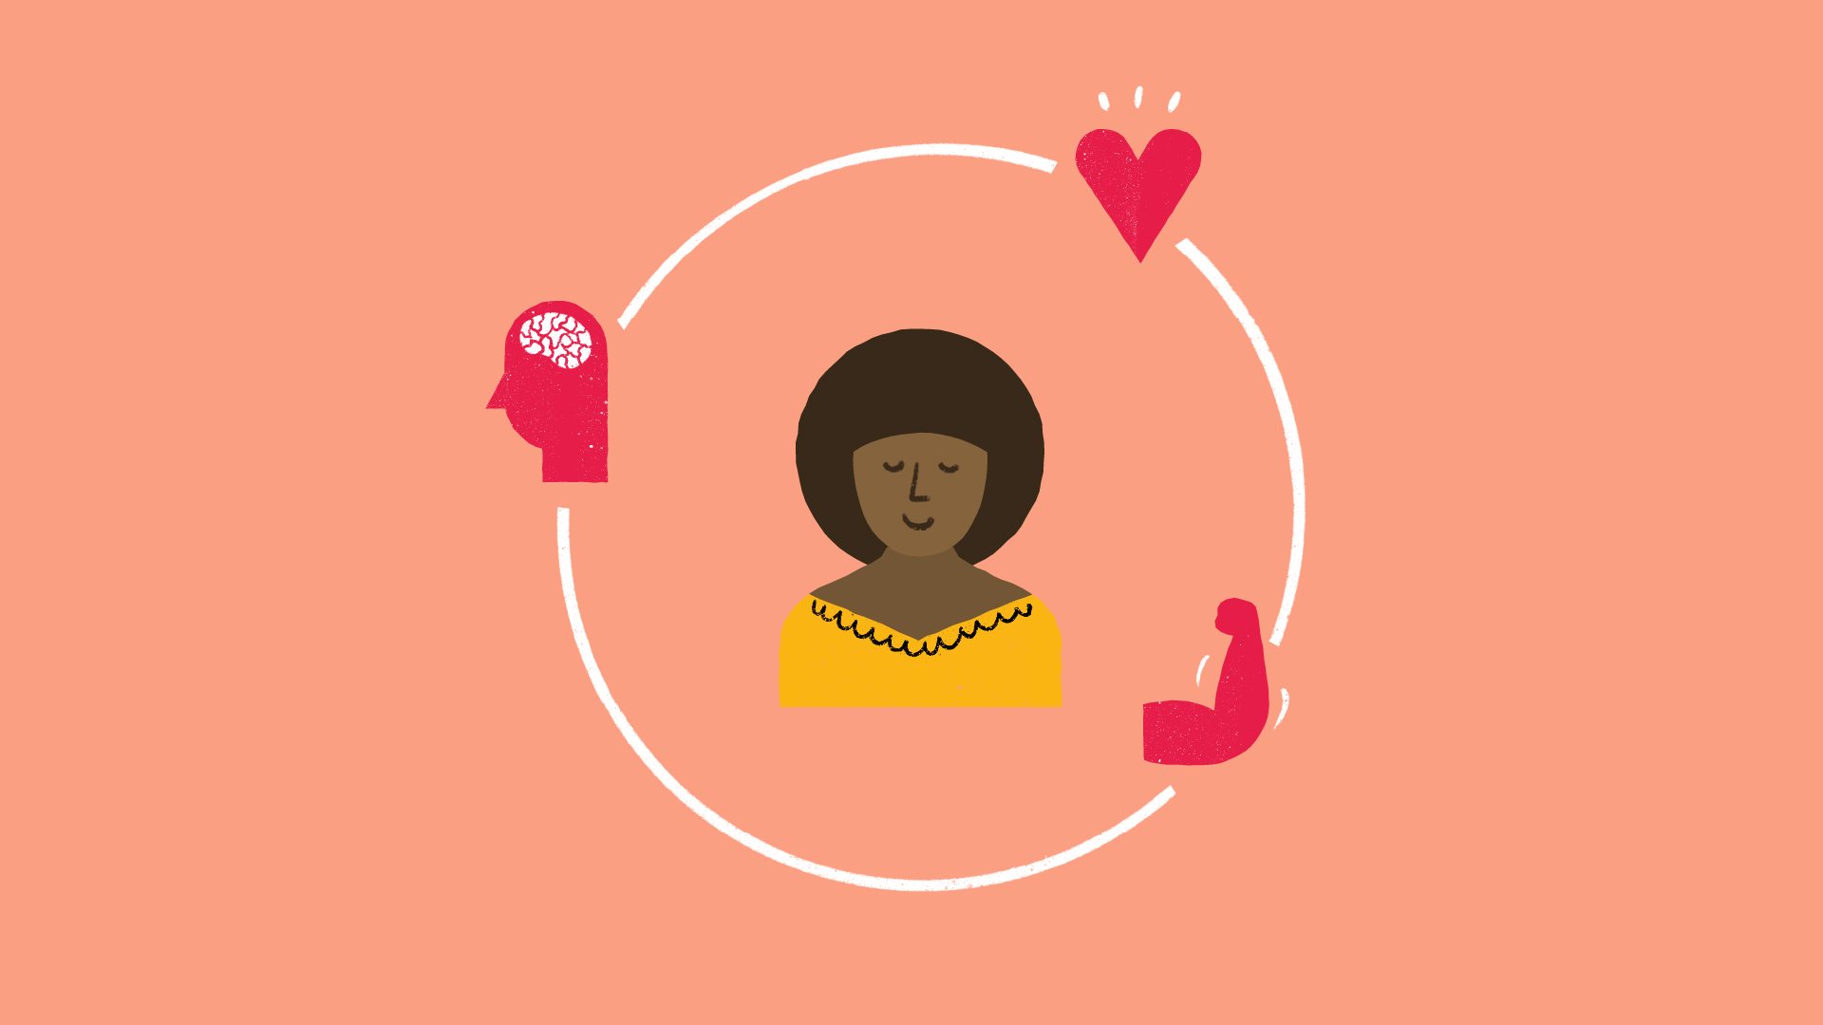
You’ll Watch Yourself Grow!
Keep track of your screen/media app time
Personal journal
Report other disorders, addictions, limitations.
Solution-Focused
Motivational
Image by IPPF, 2021.
Notes:
Like any form of treatment, there’s work. All the user needs is to keep a journal, whether it be physical or simply in their notes app. They can report their screen time on certain social media sites/apps and their personal feelings, behaviors, etc. They should also keep notes on anything that may be affecting their treatment, such as another disorder or issues at home. A positive, solution-focused (large) section should also be kept in order to recognize and reward ideal behavior. The success will look like achieving your personal time goals, reconnecting with your passions and loved ones, being able to focus on studies/work, and remaining in-control when entertainment or simulation is slight.

Slide 12
Information References
Admin. (2021, April). Dopamine. healthdirect. https://www.healthdirect.gov.au/dopamine#:~:text=my%20dopamine%20levels%3F-,What%20is%20dopamine%3F,send%20messages%20to%20each%20other.
Admin. (2023, March 21). Tiktok statistics - everything you need to know [Mar 2023 update]. Wallaroo Media. https://wallaroomedia.com/blog/social-media/tiktok-statistics/#:~:text=Average%20Minutes%20Per%20User%20%E2%80%93%20TikTok,users%20have%20posted%20a%20video.
Atske, S. (2022, December 15). Teens, social media and technology 2022. Pew Research Center: Internet, Science & Tech. https://www.pewresearch.org/internet/2022/08/10/teens-social-media-and-technology-2022/
Atske, S. (2022, May 11). Social media use in 2021. Pew Research Center: Internet, Science & Tech. https://www.pewresearch.org/internet/2021/04/07/social-media-use-in-2021/#:~:text=Some%2084%25%20of%20adults%20ages,45%25)%20report%20doing%20this.
Capuzzi, D., & Stauffer, M. D. (2019). Foundations of Addictions Counseling (4th ed., pages 163-168). Pearson Education (US). https://mbsdirect.vitalsource.com/books/9780135169858
Dixon, S. (2022, June 14). U.S. Social Media Addiction by age group 2019. Statista. https://www.statista.com/statistics/1081292/social-media-addiction-by-age-usa/
Notes:
Many therapists recommend mindfulness for addictions to things we will continue to consume (such as food, alcohol, or sex). However, there are extensive resources. If you’ve found yourself reliant on social media, you’re not alone. As mentioned in slide three, this addiction effects millions of individuals, and at no surprise. This program will be available to high school and college students ages 15-25. Although it will primarily be offered at schools, anyone 15-25 who is battling social media addiction can implement the aforementioned strategies at home or within a support group.

Slide 13
Information References Cont.
Robinson, L. (2023, March 29). Social Media and Mental Health. HelpGuide.org. https://www.helpguide.org/articles/mental-health/social-media-and-mental-health.htm#:~:text=However%2C%20multiple%20studies%20have%20found,about%20your%20life%20or%20appearance.
Satici, S. A., Gocet Tekin, E., Deniz, M. E., & Satici, B. (2023). Doomscrolling Scale: Its association with personality traits, psychological distress, social media use, and Wellbeing. Applied research in quality of life. https://www.ncbi.nlm.nih.gov/pmc/articles/PMC9580444/
SEJ ST. (2023, April 10). The Top 10 Social Media Sites & Platforms. Search Engine Journal. https://www.searchenginejournal.com/social-media/biggest-social-media-sites/#close

Slide 14
Picture References
International Planned Parenthood Foundation. (2021). Why Should You Care About Self-Care? IPPF Blogs. https://www.ippf.org/blogs/why-should-you-care-about-self-care
Jennings, Rebecca. (2022). Chronically Online. Vox. https://www.vox.com/the-goods/23497207/chronically-online-twitter-tiktok
Meghan Salsbury. (2021). A Profile of Social Media Addiction. The Observer. https://cwuobserver.com/17010/news/a-profile-of-social-media-addiction/#
Power of Positivity. (2021). https://www.powerofpositivity.com/social-media-addiction-links-depression/
Ukraine, Kyiv. (2019). Social Media Apps Logotypes Printed on a Cubes stock photo. PresurreUA. https://www.istockphoto.com/photo/social-media-apps-logotypes-printed-on-a-cubes-gm1173494845-325964651?utm_medium=organic&utm_source=google&utm_campaign=iptcurl
Rathor, Garima. (2020). What Is Cognitive-Behavioral Therapy (CBT)? Does It Work? Spark.Live. https://medium.com/spark-live/advantages-of-cognitive-behavioral-therapy-cbt-88bff0ab98d3
ZyMos. (2019). Myspace.svg. Wikapedia. https://en.m.wikipedia.org/wiki/File:Myspace.svg

